Slide 1
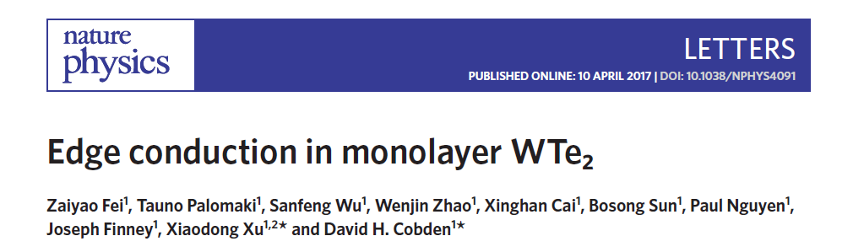

Slide 2
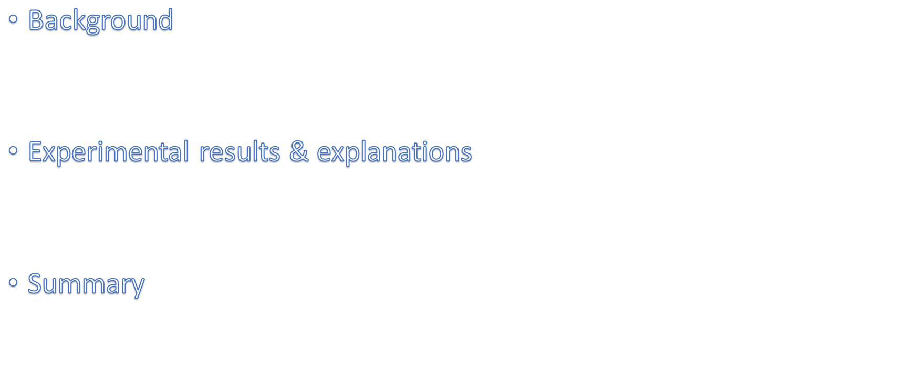
Outline

Slide 3
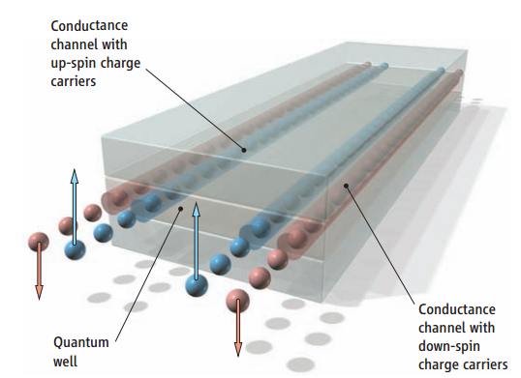
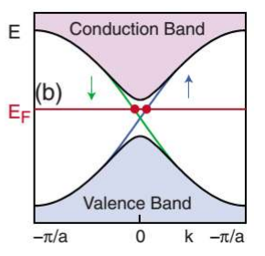



Slide 4
The conductance at low temperatures is not perfectly quantized, becoming small in long edges
The edge conductance showing mesoscopic fluctuations as a function of gate voltage.
The edges show signs of conducting even at high magnetic field.
Non-helical edge conduction may also be present, due for instance to band bending when a gate voltage is applied in the quantum wells.
So, identification of a natural monolayer 2DTI would be helpful for elucidating and exploiting TI physics

Slide 5
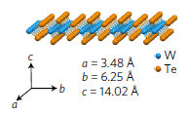
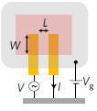
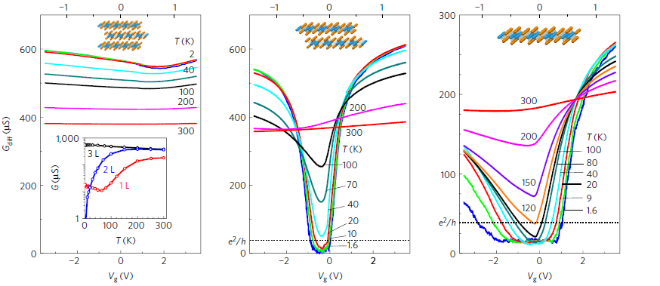

Slide 6
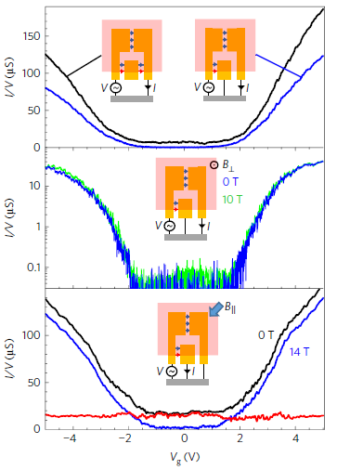
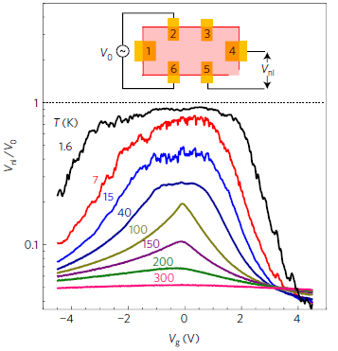

Slide 7
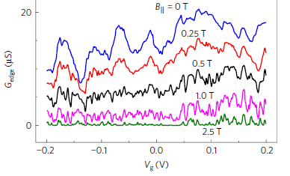
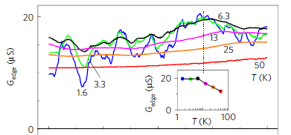
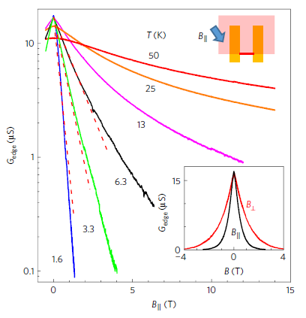
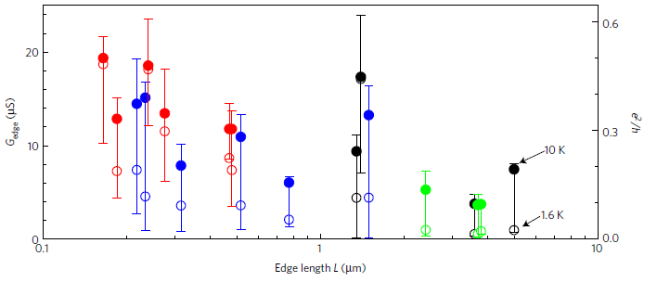

Slide 8
The monolayer edge conductance is independent of Vg. This is consistent with a single gapless mode, and not with carrier accumulation due to band bending.
No edge conduction in bilayers. This can be explained by the fact that TR symmetry does not prohibit backscattering at the bilayer edge.
The conductance is dramatically suppressed by B//, consistent with the expectation that elastic backscattering is allowed once TR symmetry is broken.

Slide 9
